Slide 1



React.js
Presented By : Saurabh Mahendra Pakhale
MCA – II ( IV Sem )
Submitted as MCA Final Year Seminar towards completion of MCA in Inter Institutional Computer Centre, RTM Nagpur University Department
Our Director
Dr. Satish Sharma Sir
Professor
Mr. Arvind Bhave Sir
Teacher
Dr. Manjiree Vyavhare Mam

Slide 2

Introduction to React.js
React.js is a powerful, open-source JavaScript library for building user interfaces. It was developed and is maintained by Facebook. React.js allows developers to create reusable UI components, efficiently manage the state of these components, and build scalable web applications.

Slide 3


History of React
React.js was first developed and released by Facebook in 2013. It was created to address the challenges faced by developers in building complex user interfaces for web applications. React's innovative approach to building UI components has since made it one of the most popular JavaScript libraries for front-end development.

Slide 4
Why to use React
Efficient Rendering: React's virtual DOM and diffing algorithm allow for lightning-fast updates, ensuring a smooth and responsive user experience. React uses Virtual DOM instead of Real DOM considering that Real DOM manipulations are expensive.
Reusable Components: React encourages a modular approach, enabling developers to create reusable UI components that can be easily integrated into larger applications.
Declarative Syntax: React's declarative programming model makes it easier to reason about and understand the structure of the user interface. Uses JSX syntax, a syntax extension of JS that allows developers to write HTML in their JS code.
Ecosystem and Community: React benefits from a thriving ecosystem of libraries, tools, and community support, making it a powerful and flexible choice for building modern web applications.

Slide 5
Key Features of React.js
Virtual DOM
Component-Based Architecture
Unidirectional Data Flow
React's Virtual DOM provides a lightweight, in-memory data structure that mirrors the actual DOM. This allows for efficient updates and re-renders of the UI.
React's one-way data binding ensures that data flows in a predictable direction, making the application state easier to reason about and debug.
React encourages developers to build the UI as a tree of reusable, self-contained components, promoting modularity and easier maintenance.

Slide 6
React.js Components
1
Functional Components
2
Class Components
Lightweight, stateless components that are defined as JavaScript functions.
Stateful components that extend the React.Component class and provide more advanced features.
3
Composite Components
4
Higher-Order Components (HOCs)
Complex components that are built by composing simpler, reusable components.
Powerful patterns for reusing component logic and enhancing component functionality.

Slide 7
State Management in React.js
State
Props
The internal data of a React component that determines its behavior and appearance.
Data passed from parent components to child components, used to customize their behavior.
setState()
Context API
A method that allows you to update the state of a React component and trigger a re-render.
A way to pass data through the component tree without having to pass props down manually at every level.

Slide 8
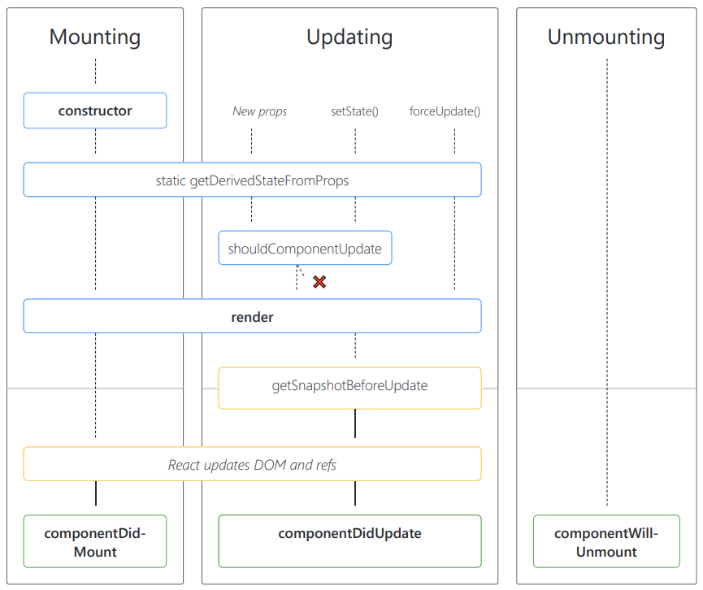

Lifecycle Methods
in React.js
1
Mounting
The process of inserting a new component instance into the DOM.
2
Updating
The process of re-rendering a component due to changes in props or state.
3
Unmounting
The process of removing a
component instance from
the DOM.

Slide 9




Routing in React.js
Browser History
Link Component
Route Matching
Nested Routing
React Router uses the browser's history API to handle client-side routing.
The Link component is used to create navigational links between routes.
React Router matches the current URL to the defined routes and renders the appropriate component.
React Router supports nesting routes, allowing for more complex application structures.

Slide 10
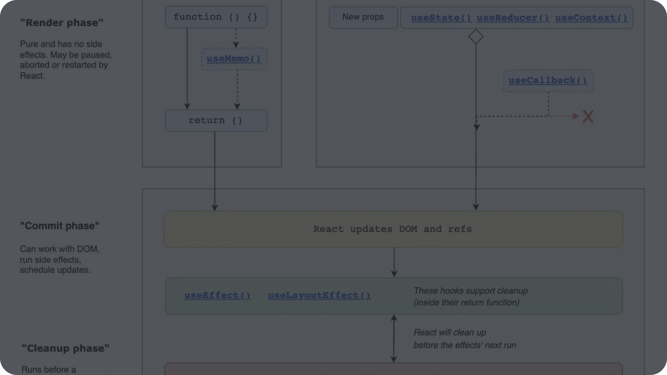



Hooks in React.js
useState()
useEffect()
Custom Hooks
Adds state to functional components, allowing them to be stateful.
Manages side effects, such as data fetching, subscriptions, and manual DOM manipulations.
Allows you to create your own reusable hooks to encapsulate component logic.

Slide 11
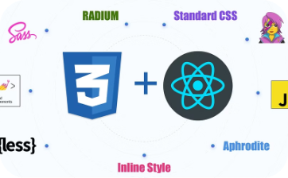
Conclusion and Next Steps
Explore the React.js Community
Continue Learning and Practicing
Join the vibrant React.js community to stay up-to-date with the latest trends, best practices, and new developments.
Enhance your skills by working on personal projects, contributing to open-source, and exploring advanced React.js concepts.

Slide 12
Thank you for your Patience !

